Slide 1
Final Capstone project
Daniel LEE

Slide 2
Business Problem
Squash has always been considered a great workout burning over 1000 calories per hour. Due to the intensity of the workout, there is a huge benefit of being able to have fun whilst exercising in a short time frame.
As London is known to be the financial hub with unpredictable weather throughout the year, Squash can be considered a great sport that one can commit to as a quick exercise without being affected by unpleasant weather.
Therefore, the business problem that needs to be addressed is:
Finding the best location to open up a squash court.

Slide 3

Source of DATA - FourSquare
To explore the best location to open a squash court, we could use FourSquare location data to explore some of the following:
Competition of Squash Centres - Number of Squash courts in a 5-miles radius
General Interest of Exercise or Workout - Number of gyms in a 2-miles radius
An investor should select a location that has minimal competition whilst maximising probability of interested customers which we will be using the above to provide the best recommendation for this.

Slide 4
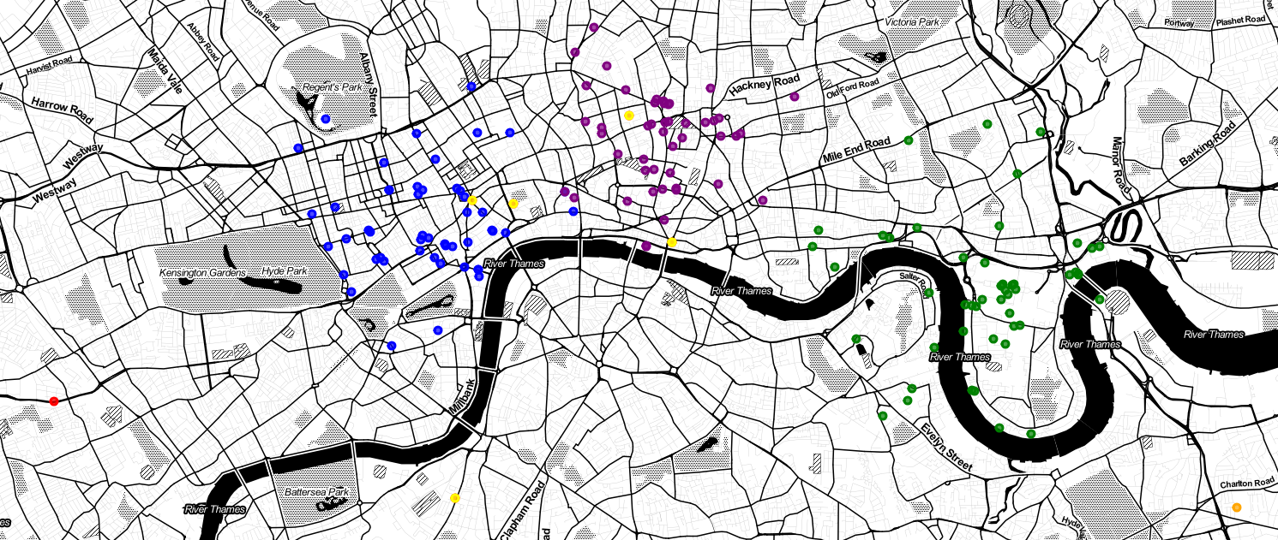
INSIGHTS
The darker colours (Blue, Purple, Green) represent the gyms within the three areas for SOHO, Shoreditch and Canary Wharf respectively.
If we can assume this is correlated to the demand of sports, there is a similar volume of gyms across the three areas.
The brighter colours (red, yellow and orange) represents the competition within the three respective regions SOHO, Shoreditch and Canary Wharf.
There is a significant opportunity within the Canary Wharf region as there is a lack of squash courts near this area despite the consistently high volume of gyms in this area.

Slide 5
Recommendation
As Canary wharf is one of the most densely populated areas by employees, the above insight poses a strong opportunity to be quite successful to open up a squash centre when only considering location as a factor

